Slide 1

AIFC INSIGHTS MONTHLY DIGEST
February 2026

Slide 2

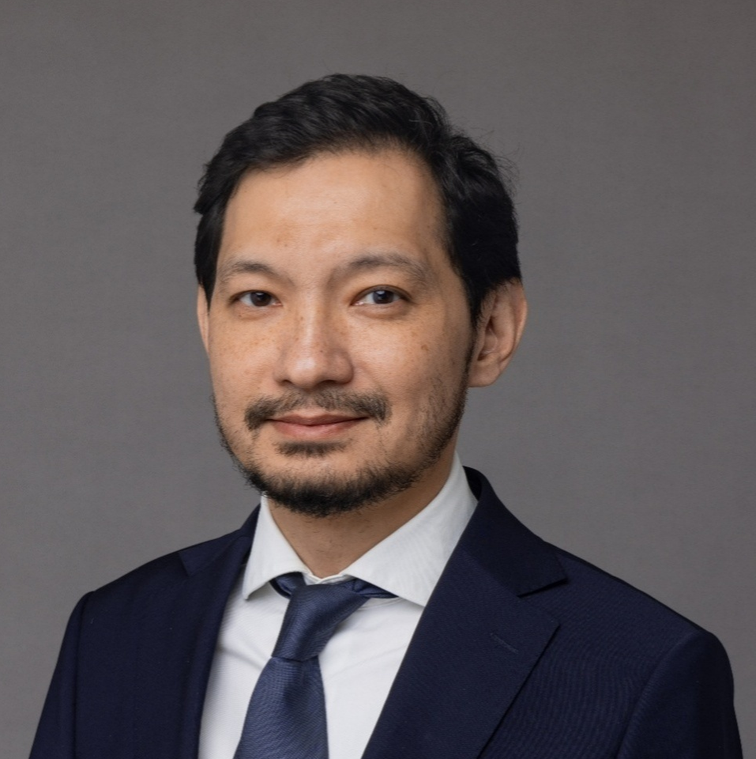



FOREWORD
From the AIFC Insights Team
ABOUT US
AIFC Insights is the analytical unit within the Astana International Financial Centre, producing data-driven research on macroeconomic trends, commodity markets, and key developments across the AIFC ecosystem.
Our publications, including industry reports, aim to advance sector knowledge in Kazakhstan by delivering market analysis on specific sectors, and evidence-based insights.
Ayan Tuleshev
Director
Diana Assaubayeva
Senior Manager
Dana Abdykayeva
Senior Manager
Ulan Kaiyrbay
Senior Manager
DEAR AIFC COMMUNITY
We, the AIFC Insights Team, are pleased to present the second issue of our regular analytical digest.
This edition covers economic activity, inflation and exchange rate dynamics, alongside commodity prices and a brief thematic insights.
We will publish this digest regularly as part of our ongoing analytical contribution to the market.
Thank you for your continued trust and collaboration
AIFC Insights Team
TABLE OF CONTENTS
1
Macroeconomic Snapshot
2
Commodities
3
AIFC Ecosystem News

Slide 3
1
1 | Macro Snapshot
KEY TAKEAWAYS
Economic activity in Jan-Feb 2026 showed marginal growth, with STEI at 100.2 (+0.2% y/y), following the January slowdown.
Sectoral dynamics remained uneven: construction and transport expanded, while industrial output stayed below prior-year levels.
Inflation eased to 11.7% y/y in February, with food prices remaining a key contributor.
The tenge strengthened, with the average exchange rate at 495.9 USD/KZT in February, compared to late-2025 and January levels.
I. SHORT TERM ECONOMIC INDICATOR (STEI)
STEI reached 100.2 in Jan-Feb 2026 (+0.2% y/y)
Sectoral dynamics were uneven: construction (+14.5% y/y), transport (+10.7% y/y), and communications (+3.8% y/y) expanded, while industrial output remained below prior-year levels (96.9%)
Agriculture and trade recorded moderate growth (+3.4% y/y each), contributing incrementally to overall activity.
Graph 1. STEI Index
As % of the corresponding period last year (prior year = 100)
Jan. - Feb.
Jan. - Mar.
Jan. - Apr.
Jan. -May
Jan. - Jun.
Jan. - Jul.
Jan. - Aug.
Jan. - Sep.
Jan. - Oct.
Jan. -Nov.
Jan. - Dec.
Jan.
Jan.-Feb.
2025
2026
Source: Bureau of National statistics
Note: *The Short-Term Economic Indicator (STEI) is calculated to provide a timely assessment of economic activity and is based on output indices across six core sectors - agriculture, industry, construction, trade, transport, and communications - which together account for over 60% of GDP
II. INFLATION DYNAMICS
Graph 2. Dynamics of annual inflation
Annual inflation stood at 11.7% y/y in February 2026, down from 12.2% in January
Food contributed the largest share to overall price growth, despite the overall deceleration in the annual rate.
Source: Bureau of National statistics
III. EXCHANGE RATE USD/KZT
Graph 3. Average Monthly Exchange Rate (USD/KZT), National Bank of Kazakhstan
The exchange rate averaged 495.9 KZT/USD in February 2026, showing a notable appreciation of the tenge from the January level of 507.6 and remaining well below the September 2025 peak.
KZT
Feb. 25
Mar. 25
Apr. 25
May 25
Jun. 25
Jul. 25
Aug. 25
Sep. 25
Oct. 25
Nov. 25
Dec. 25
Jan. 26
Feb. 25
Source: National Bank of Kazakhstan

Slide 4
2 | Commodities
KEY TAKEAWAYS
Commodity prices strengthened in early 2026, with oil rebounding to $71.1/bbl, copper near $13000/t, and gold around $5020/oz.
Kazakhstan’s oil production rebounded, reaching 6.8 million tonnes in February, up 29% m/m.
Metals output in Kazakhstan increased, with copper production reaching 48.9 thousand tonnes and gold output rising to 9534 kg.
I. CRUDE OIL (BRENT)
Graph 4. Brent price
$/bbl, monthly averages
WORLD
Brent crude averaged $71.1/bbl in February 2026, recovering from a recent low of $62.7/bbl in December 2025 and returning to levels last seen in the summer of 2025.
Crude oil and gas condensate production reached 6.8 million tonnes in February, up 29% m/m from 5.25 million tonnes in January.
KAZAKHSTAN
Source: World Bank, Bureau of National statistics
II. COPPER
Graph 5. Copper Prices
$/mt, monthly averages
WORLD
Copper prices averaged $12951/mt in February 2026, slightly below January levels, marking a 38.8% increase from $9331/mt a year earlier.
Copper content in copper concentrate production reached 48.9 thousand tonnes in February (+9.2% m/m). The Ministry of Industry plans to grow copper output to 502.1 thousand tonnes in 2026 (+6.6%), driven by the launch of new producers: Shagala Mining, BMT Holding, Kyzyl Aray Copper.
KAZAKHSTAN
Source: World Bank, gov.kz, Bureau of National statistics
III. GOLD
Graph 6. Gold price
$/troy oz, monthly averages
WORLD
Gold prices averaged $5020/oz in February 2026, up 73% y/y from $2895/oz recorded in the same period last year.
Production of unwrought and semi-manufactured gold reached 9534 kg in February, up 23.6% m/m from 7715 kg in January.
KAZAKHSTAN
Source: World Bank, Bureau of National statistics

Slide 5
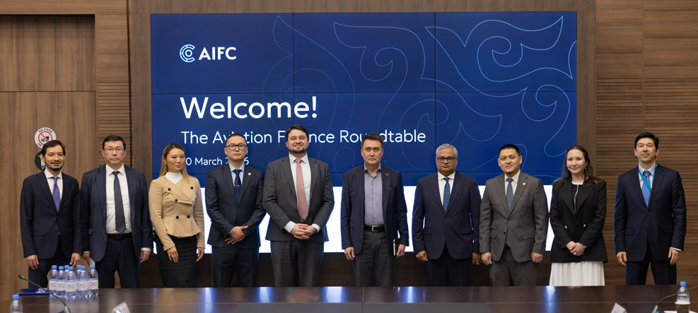
3 | AIFC Ecosystem News
AIFC AVIATION HUB: THE AIFC IS DEVELOPING A REGIONAL PLATFORM FOR AIRCRAFT FINANCING AND LEASING
Recent developments
AIFC convened an industry roundtable on aviation finance
A dedicated report on regional aviation finance is in preparation
1. Market developments Aviation industry
3. AIFC as Central Asia’s leasing jurisdiction
A framework built to match global leaders
Global passenger traffic and fleet size are projected to double over the next 20 years
Central Asia and the Caucasus show strong growth potential in air transport
Demand for aircraft financing and leasing is increasing
The AIFC provides a top-tier aviation leasing jurisdiction rooted in English common law, creating a compelling regional platform that complements established hubs like Ireland and Singapore
The AIFC provides a highly competitive fiscal advantage by combining exclusive CIS tax treaty benefits with full CIT and VAT exemptions, generating a distinct edge across Central Asian and Caucasus markets through Kazakhstan’s network of over 55 double taxation treaties
Asset security is further reinforced by the implementation of the Cape Town Convention and IDERA protocols, bolstered by a proven 82% ICAO safety compliance level that provides a stable foundation for international leasing
2. Industry structure
Aircraft leasing accounts for ~60% of the global fleet
Up to 80% in some regional markets
Aircraft leasing reduces upfront capital requirements and improves fleet flexibility

Slide 6

DISCLAIMER
This “AIFC Analytical Digest” (“digest”) has been prepared for informational purposes only and does not constitute legal, financial, or professional advice. The information contained in this digest is provided on an "as is" basis without any representations or warranties, express or implied, regarding the accuracy, completeness, or reliability of the information.
The content of this digest may contain opinions, projections, or forward-looking statements that are subject to change without notice. Any reliance you place on the information contained in this review is strictly at your own risk. We disclaim all liability and responsibility arising from any reliance placed on such materials by you or any other party.
This digest may reference external sources or links to third-party websites for additional information or context. However, we do not endorse or control the content of any third-party websites and are not responsible for the accuracy, legality, or content of such websites.
Nothing in this digest should be construed as creating a client relationship between the reader and our organization. If you require legal, financial, or professional advice, you should consult with a qualified professional who can provide tailored advice based on your specific circumstances.
We make no representations or warranties regarding the suitability, reliability, availability, timeliness, or accuracy of the information contained in this digest for any purpose.
We shall not be liable for any direct, indirect, incidental, special, consequential, or punitive damages arising out of your use or inability to use this digest.
We reserve the right to modify or update this digest at any time without prior notice.
All data in this digest is as of 19 March 2026.

Slide 7

AUTHORS
CONTACT INFORMATION
AIFC Insights
Ayan Tuleshev Director, Industry Analysis Department
Diana Assaubayeva Senior Manager, Industry Analysis Department
Dana Abdykayeva Senior Manager, Industry Analysis Department
industry.analysis@aifc.kz
www.aifc.kz

